Slide 1
Minor Project Report on
Shri Shankaracharya Institute of Professional Management & Technology, Raipur
Student Feedback Sentiment Analyser
CSE 7th Semester
Department of Computer Science and Engineering,
Batch 2018-2022
Session July – Dec 2021
Project Guide
Prof. Guide Name
Dr. Chaitali Biswas Dutta
(Assistant Professor, CSE)
Project Group Members:
ADHIREDDY PRAVEEN KUMAR ANIRUDH GOPAWAR DEVWRAT SINGH

Slide 2
OBJECTIVE
It is crucial to understand the patterns generated by student feedback data to effectively improve the performance of the institution. There is also a requirement to automate the student feedback system in order to handle a large amount of data and analyse them effectively.
To achieve this proposed system is created for educational data mining. Educational data mining refers to practices, mechanisms and researches invented for automatically extracting meaning from large repositories of data generated by or related to student’s learning activities in educational system.

Slide 3
About The Project
Student Feedback Sentiment Analysis is a tool that helps admin or university to check student feedback for the university and faculty. This tool primary purpose is to identify the problem in the university by the student feedback. This tool performs sentiment analysis to findout the data insights from the student feedback.
This tool will give the quick and accurate result to the admin by performing analysis on feedback data. So that university can figure out the real problem in the system and fix it as soon as possible.

Slide 4
This tool can be used in other business like, to check customer review in restaurants and hotels, only thing need to be change is dataset. To find out customer wants and expectation, this tool can be used to perform sentiment analysis on customer feedback data for the hotel and restaurants and their food.
There is no system present in our university which helps university and department to track the student feedback. To solve this problem, proposed system is designed to take the feedback from the student using feedback form and admin has a facility to perform sentiment analysis on that data to find out the students requirements effectively.

Slide 5
Hardware and Software Requirement
1. Hardware Specification
RAM 4 GB
GPU
2. Software Requirements:
Python
PyCharm
Browser to Test
Power BI

Slide 6
➢Proposed system main functions are –
Take input from the student using feedback form.
Allow admin to perform sentiment analysis on the data.
Give full insights from the data as a output

Slide 7
SCOPE
Proposed system investigating and analyzing student sentiments, by using this system
admin able to get an inside look at student behaviors and wants.
Our proposed system currently working for branch and departments, so that department HOD can get the full insights and report from the student directly to improve system effectively.

Slide 8
Product Perspective
SAT is a continuation of the feedback data sentiment analysis tool which is used to find the customer or user sentiments in the feedback.
SAT is developed for the university to perform analysis on the student feedback so that admin can understand the real problem in the system and students requirements. This tool gives full insights of the feedback data using Machine Learning Algorithm.

Slide 9
The main feature of this tool is-
It allows university admin to perform analysis on the student feedback dataset.
Perform analysis and give insights from the data and represent in charts and tables.
Different libraries are used to perform sentiment analysis and data visualization, some of them are -
sklearn
NLTK
Pandas
Matplotlib

Slide 10
This application represents end result in word cloud, confusion matrix, classification report and pie charts.
This is highly scalable and can be used in different scenarios like to perform analysis hotel and restaurant feedback. It was developed to run on Window, Mac OS X and Linux.

Slide 11
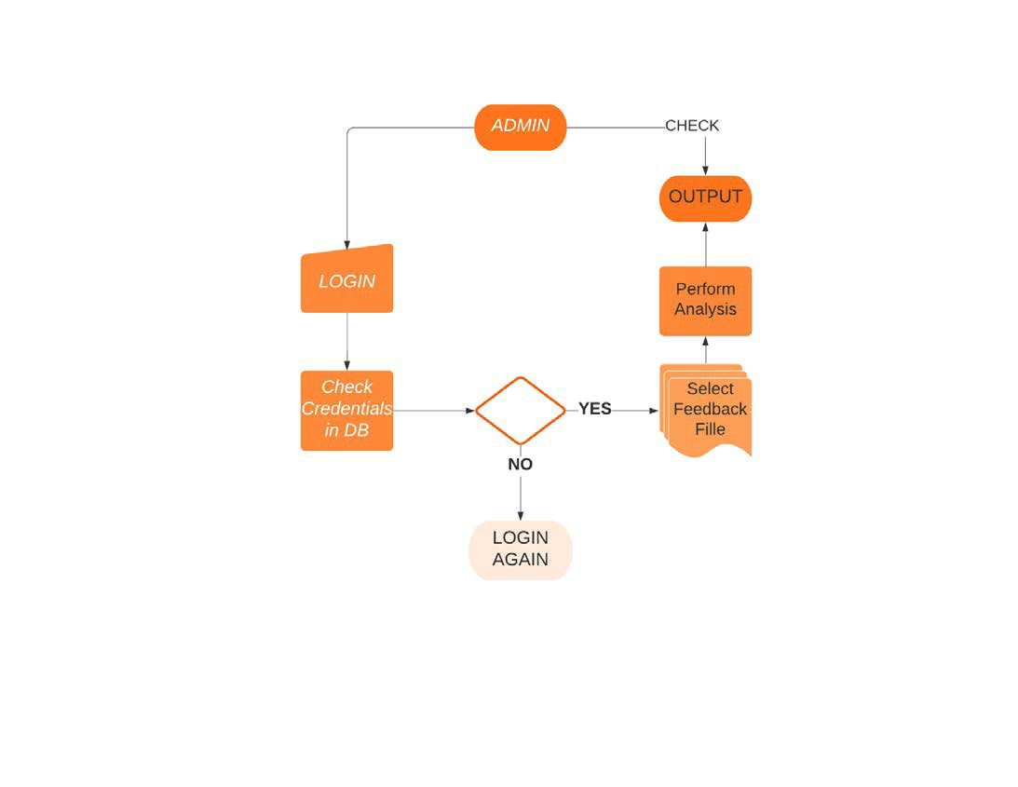
WORK FLOW DIAGRAM

Slide 12
Product Functions
Function Requirement
ID | Title & Description
FR1 | Title: Login Desc: The admin and user able to login into system.
FR2 | Title : File Selection Desc: The admin will be able to select file.
FR3 | Title: Test & Train Desc: This feature allow admin to perform analysis on dataset
FR4 | Title : Dashboard Desc: Here admin can check the data Insights.
FR5 | Title: Feedback Form Desc: Student should be able to give feedback here.
FR6 | Title: Dump data Desc: Student feedback should be dump in excel file.

Slide 13
Non Function Requirement
ID | Title & Description
NFR1 | Title: Responsive Desc: System Design should be responsive
NFR2 | Title : Response Desc: Data analysis time should be quick.
NFR3 | Title: UI Desc: System UI should be user friendly.
NFR4 | Title : Compatibility Desc: System should be compatibile.
NFR5 | Title: Support Desc: Proposed System should support all browser.
NFR6 | Title: Scalable Desc: System should be scalable.

Slide 14
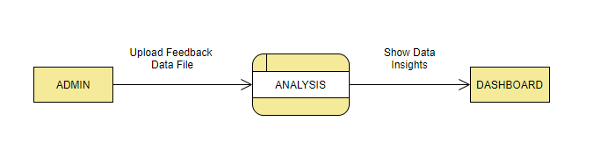
DFD Level-0

Slide 15
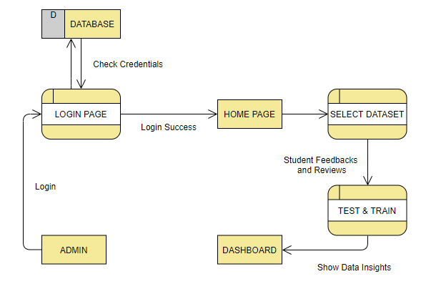
DFD Level-1

Slide 16
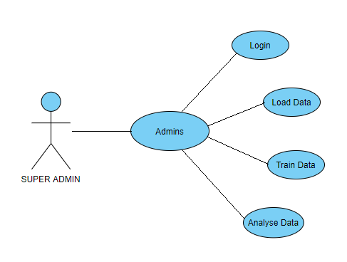
Use Case Diagram

Slide 17
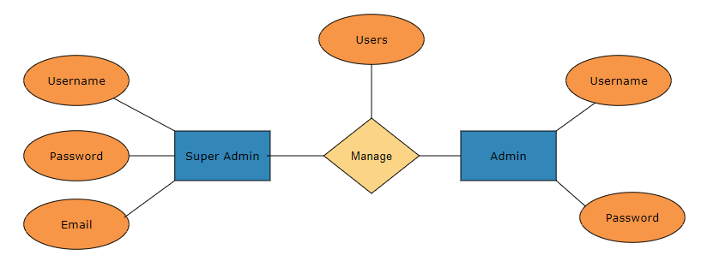
ER Diagram

Slide 18
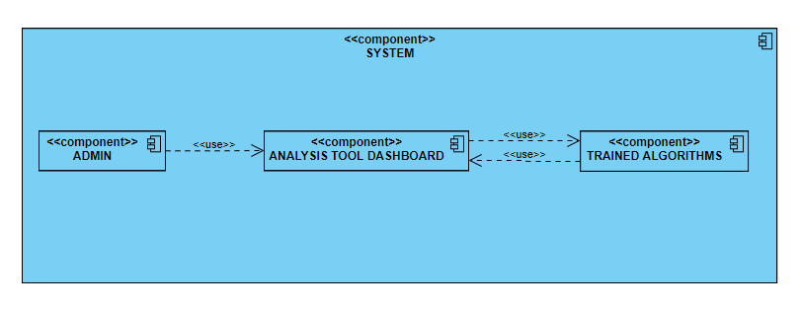
Component Diagram

Slide 19
Thank You

